Slide 1
Consumer Shopping Trends 2026
The Profit-Satisfaction Matrix: A Strategy for Sustainable Growth
Current Trends, A/B Validation, and Financial ROI

Slide 2
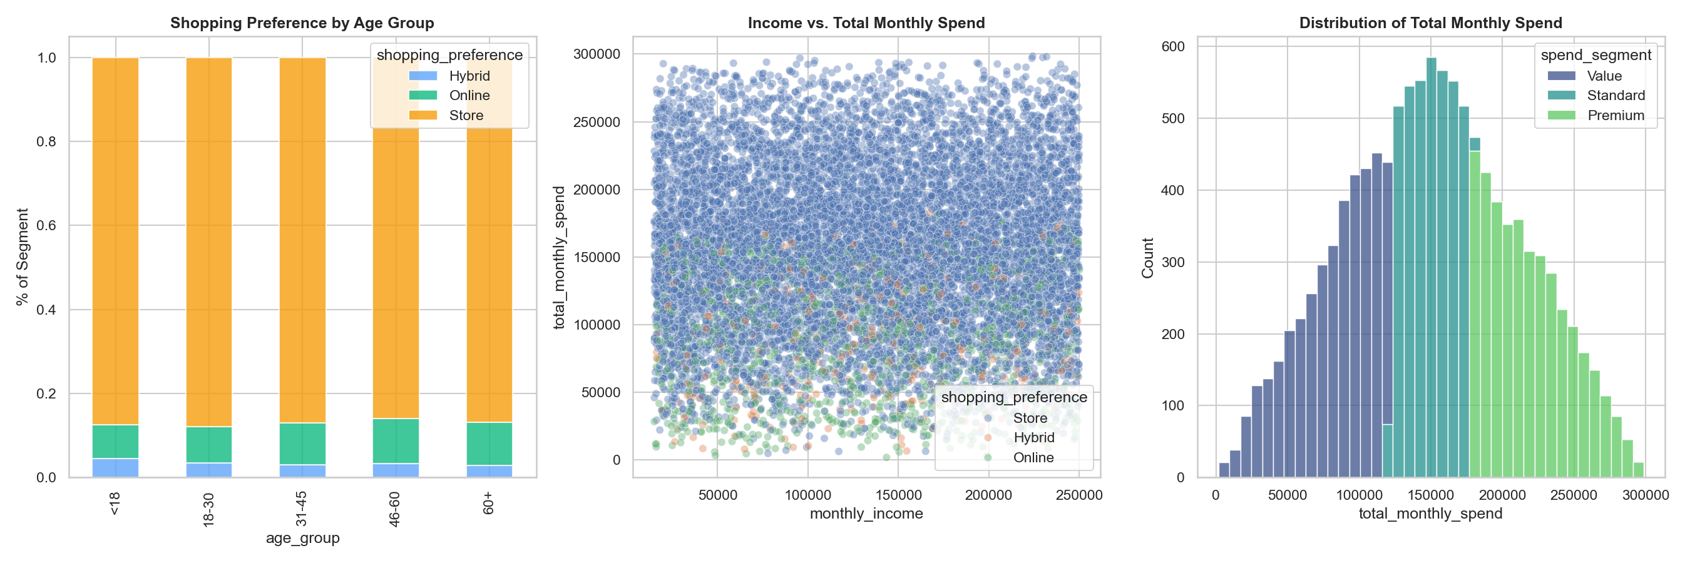
The Preference Gap: Current Trends
REFINED SEGMENTATION:
• PREMIUM: 99.9% Store | 0.0% Online | 0.1% Hybrid
• VALUE: 71.5% Store | 22.1% Online | 6.4% Hybrid
THE STORE DOMINANCE:
• High-value customers are 100% Store-loyal due to 'Touch/Feel' needs. Digital is a 'Value' behavior.

Slide 3
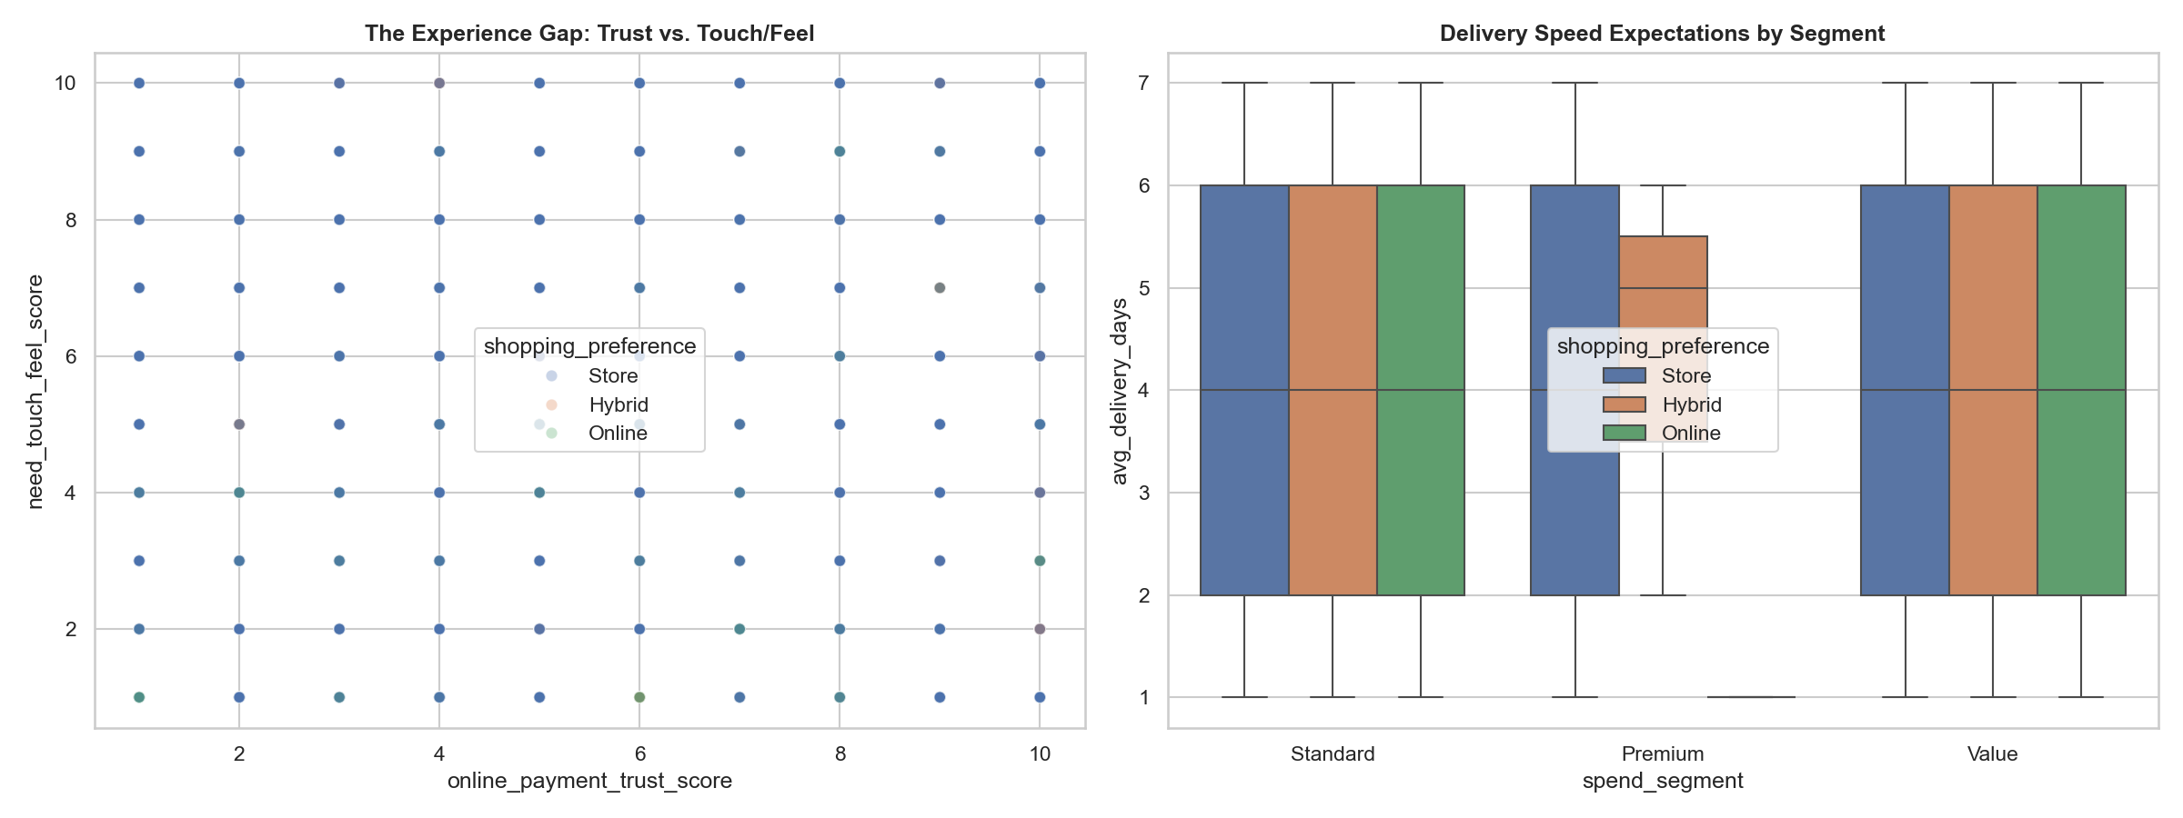
Opportunities: Areas for Improvement
THE FRICTION GAP:
• Online/Hybrid adoption is limited by Trust and Tech-Savvy scores (10% lower for Store-loyalists).
THE UNTAPPED MODEL:
• Only 3.1% Hybrid adoption. Bridging digital discovery with physical fulfillment is a major growth lever.

Slide 4
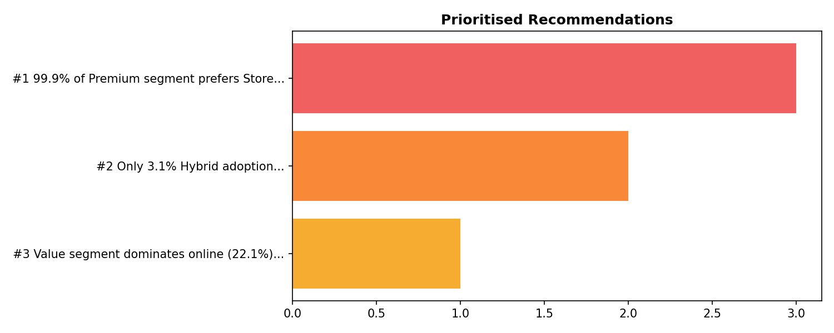
Validation: A/B Test Hypotheses
TEST 1: Premium Hybrid Growth
• Hypothesis: Reserve-In-Store will increase Premium conversion by reducing friction.
TEST 2: Value Online Trust
• Hypothesis: Speed & Trust seals will increase Value segment spend.
TEST 3: Targeted Value Rewards
• Hypothesis: Basket-value incentives will drive higher frequency for Value shoppers.

Slide 5
Validation: A/B Test Results
TEST 1 (PREMIUM HYBRID): WIN
• Result: +5.6% Conversion (p < 0.0001).
TEST 2 & 3 (VALUE SEGMENT): LEARN
• Result: No significant spend increase (p > 0.2).
CONCLUSION:
• Premium Hybrid is the proven growth lever. Value shoppers are highly budget-stable.

Slide 6
ROI: Defensible Growth Recommendations
PREMIUM HYBRID ROI: 341.4%
• Net Profit Increase: $22,071 / Customer / Year.
• Strategy: High-touch Boutique Hybrid ($5,000 cost).
VALUE BREAK-EVEN:
• 0.025% lift needed to cover rewards. Despite low cost, zero lift makes it a 'deadweight loss'.

Slide 7
Strategy: The Sustainable Roadmap
PHASE 1: Premium Hybrid Roll-out
• Deploy 'Reserve Online, Pick-up In-Store' for high-value items immediately.
PHASE 2: Value Segment Retention
• Maintain current Online Value offerings; stop chasing marginal spend growth via incentives.
THE RED LINE:
• Reallocate marketing budget from Value rewards to Premium service innovation.

